Slide 1
Introduction to Node.JS and API
Adriana Capua

Slide 2
Agenda
Basics of JavaScript
Basics of Node.JS
Introduction to RESTful API
Git Concepts

Slide 3
Basics of JavaScript

Slide 4
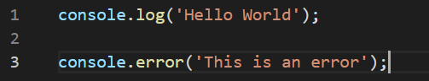
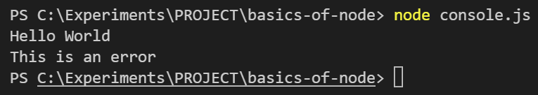
Console Output
console.log
Writes logs or message to the console
console.error
Writes an error message to the console

Slide 5
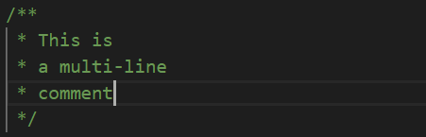
Comments
Single-line
Multi-line

Slide 6
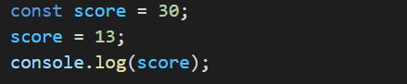
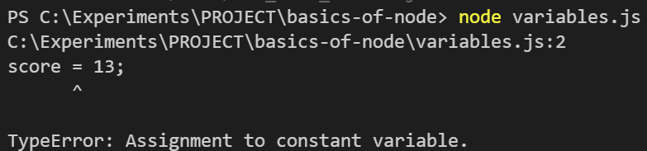
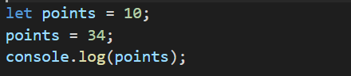
Variables
var
Globally scope
let
Block level scope. Value can be reassigned.
const
Block level scope. Value can’t be reassigned.

Slide 7
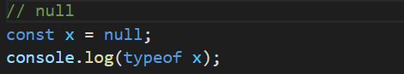
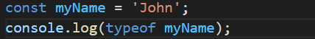
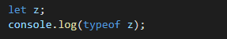
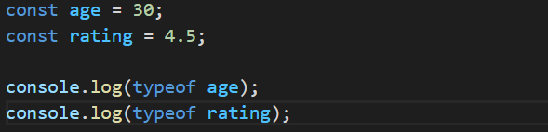
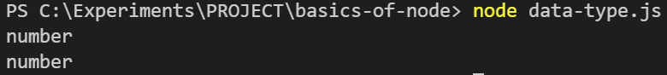
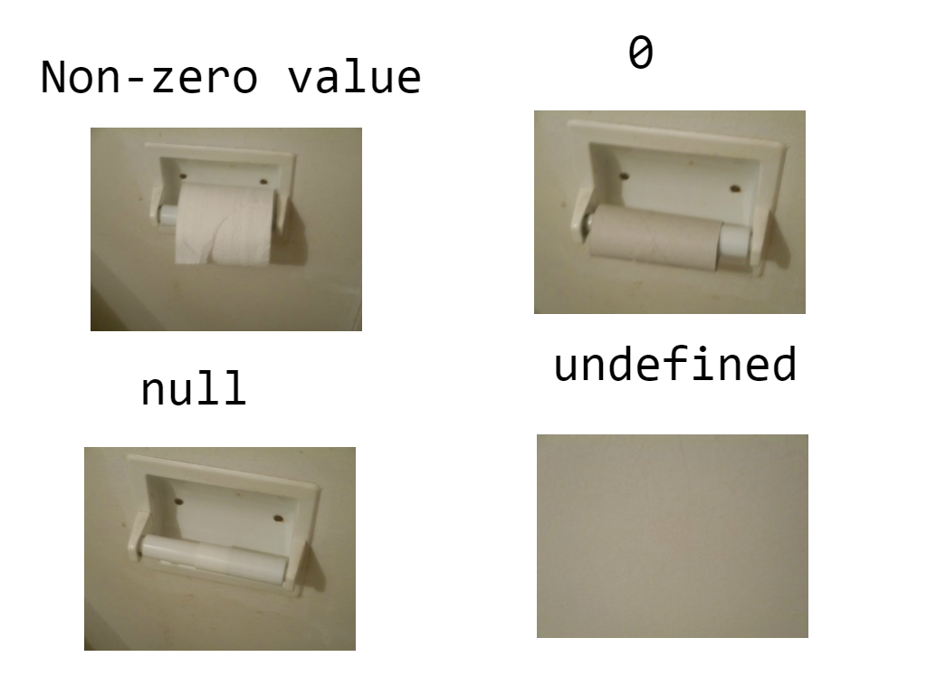
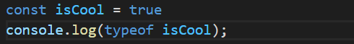
Primitive Data Types
null
String
undefined
Number
Boolean

Slide 8
String Operations
Concatenation
Template String

Slide 9
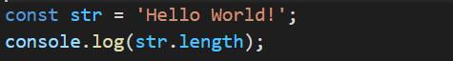
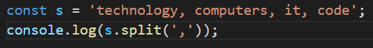
String Properties and Methods
Length
Substring
Upper Case
Split
Lower Case

Slide 10
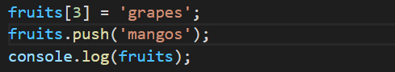
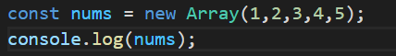
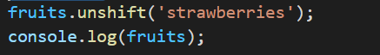
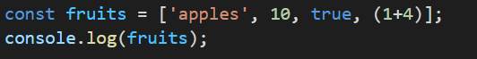
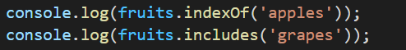
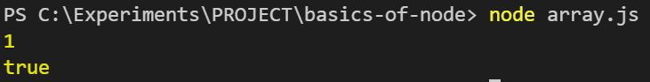
Array
You can manipulate it
Using Constructor
Using unshift to put item on the beginning
Using square bracket
Find item in the array

Slide 11
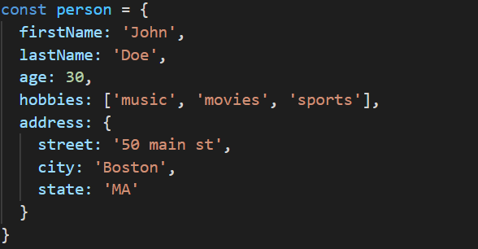
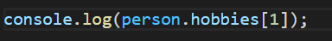
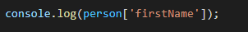
Object Literals
Defining an object
Accessing Values
This is also possible

Slide 12
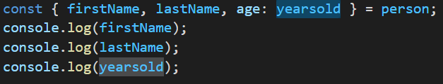
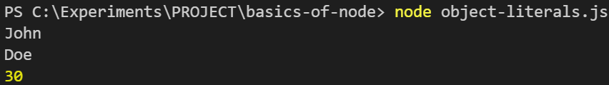
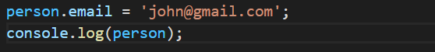
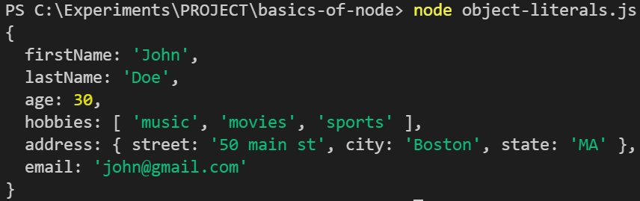
Object Literals
De-structuring
Defining an object
Adding a property

Slide 13
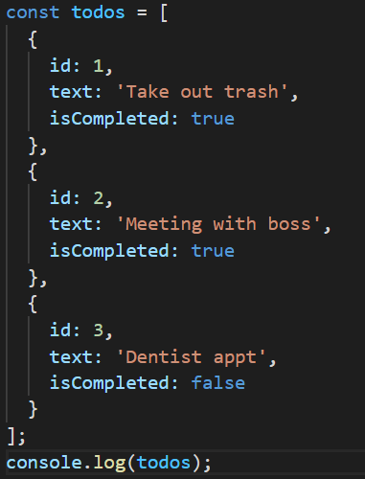
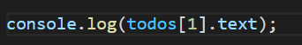
Array of Objects
Defining an array of object
Accessing array of objects

Slide 14
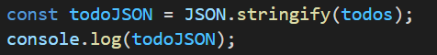
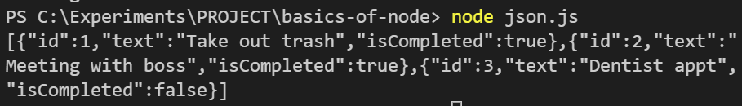
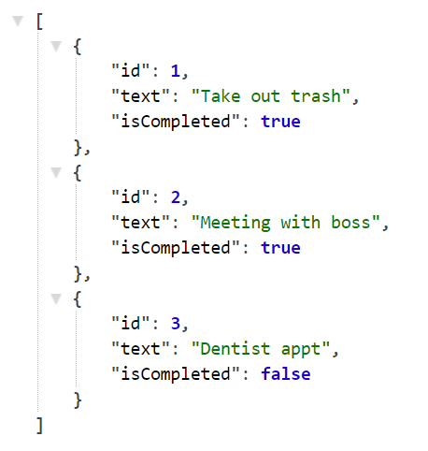
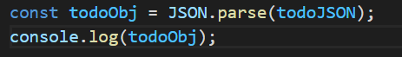
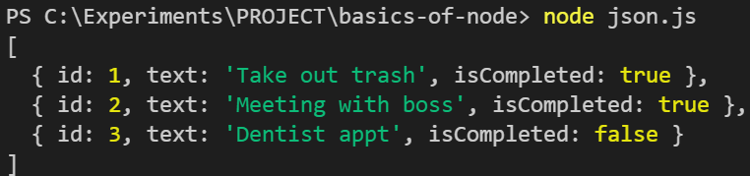
JSON
JSON.stringify()
JavaScript Object Notation
Data-interchange format
Self-describing
Most use-case are APIs and web services
JSON.parse()

Slide 15
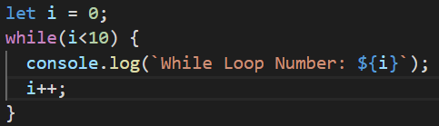
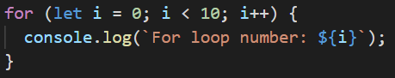
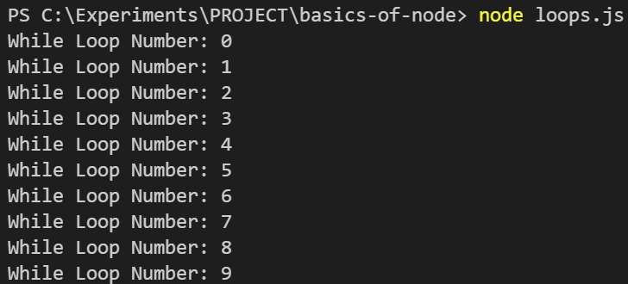
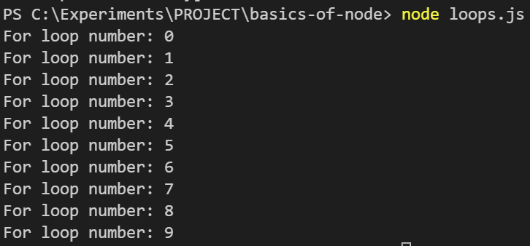
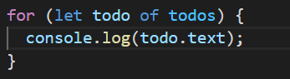
Loops
While Loop
For Loop
For loop thru an array

Slide 16
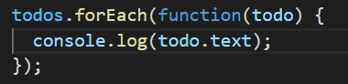
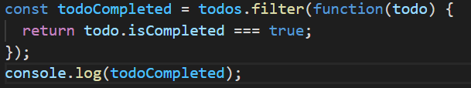
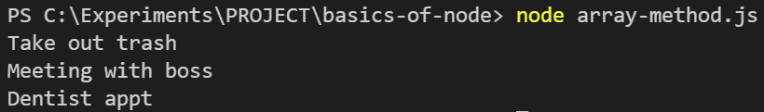
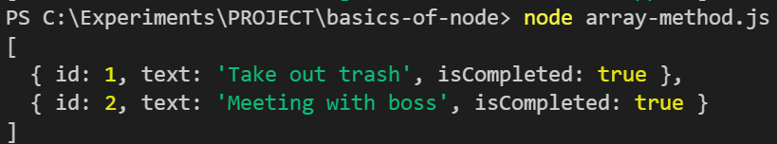
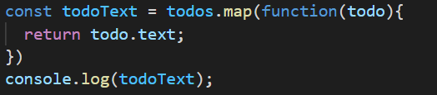
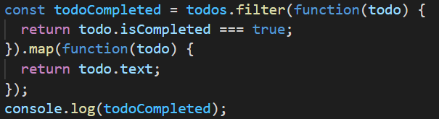
High Order Array Methods
forEach
filter
map
Methods can be chained

Slide 17
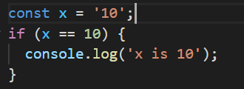
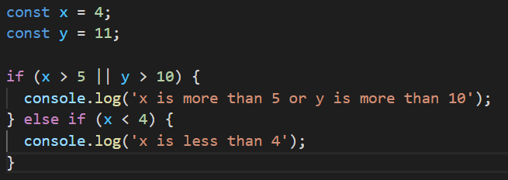
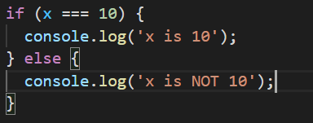
Conditional Statements
== only matches the value
else-if
=== matches the value and data type
OR is || while AND is &&

Slide 18
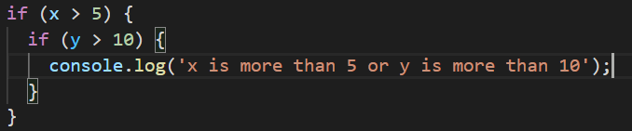


Conditional Statements
Nested statements
switch
Ternary operator

Slide 19




Function
Function keyword
Returns a value
With default value

Slide 20




Arrow Function
Best to use in array methods
Shorthand if there only 1 expression in the block
Shorthand if there only 1 parameter

Slide 21





OOP
Constructor Function

Slide 22


Classes
Using Class

Slide 23
Basics of Node.JS

Slide 24

What is Node.JS?
A runtime environment for executing JavaScript code. (Not a language or a framework)
Essentially allows us to run JavaScript code on the server
Fast, efficient and highly scalable
Event driven, non-blocking I/O model

Slide 25

Non-Blocking I/O
Works on a single thread using non-blocking I/O calls
Supports tens of thousands concurrent connections
Optimizes throughput & scalability in apps with many I/O operations
Supports concurrency via events & callbacks
All of this makes Node.JS apps very fast & efficient

Slide 26

NPM
Node Package Manager
Install 3rd party packages (frameworks, libraries, tools, etc)
Packages get stored in the “node_modules” folder
All dependencies are listed in a “package.json” file
NPM scripts can be created to run certain tasks such as run a server
npm init
Generates a package.json file
npm install express
Installs a package locally
npm install –g nodemon
Installs a package globally
npm install
npm install --production

Slide 27
Node Modules
Node Core Modules (path, fs, http, etc.)
3rd party modules / packages installed via NPM
Custom modules (files)
const path = require(‘path’);
const myFile = require(‘./myFile’);

Slide 28

Installation
https://nodejs.org/en/download/

Slide 29


Creating a Node Project
package.json file
package-lock.json tracks versions of the packages we installed

Slide 30




Installing Packages
npm install <package>
npm install –-save-dev <package>
OR npm install –D <package>

Slide 31



Running a script
node <filename.js>
.js extension can be omitted

Slide 32


Module Wrapper Function
You can create a custom module and use its contents in other files.
Using module.exports
(function (exports, require, module, __filename, __dirname) {
})

Slide 33




Path Module
We have access to __filename since .js file is just basically a module
path.basename
path.parse
path.dirname
path.join

Slide 34



FS Module
fs.writeFile()
fs.readFile()

Slide 35
Sync VS Async
Synchronous
“blocking”
Halts the program until all the resources are available
Asynchronous
“non-blocking”
The program continues executing and doesn’t wait for external resources (I/O) to be available.

Slide 36



Async using Callbacks
Callback is a function called at the completion of a given task.
setTimeout()
Nested setTimeouts
= callback hell

Slide 37

Async using Callbacks
Error first callback
If your code requires a lot of callback dependencies, it can get complicated and hard to read. This is referred as the “Callback Hell”

Slide 38


Async using Promise
Promise is a placeholder for a value that will be available in the future. It can be resolved or rejected.
Use .then to handle promise when it gets resolved and .catch when it gets rejected.

Slide 39


Async using Promise
Another example of promises using fetch

Slide 40


Async using Async/Await
The function that is calling an “asynchronous” source must be denoted by async keyword and when calling the source use await.
Use try-catch to handle errors while using Async/Await

Slide 41


Async using Promise.all
Promise.all() method takes an iterrable of promises as an input and returns a single Promise that resolves to an array of the results of the input promises.
Use Promise.all() to fire array of Promises all at once

Slide 42
Introduction to Restful API

Slide 43


What is API?
Application Program Interface
APIs are everywhere
Contract provided by one piece of software to another
Structured request and response

Slide 44
What is REST API?
Representational State Transfer
Architecture style for designing networked applications
Relies on a stateless, client-server protocol, almost always HTTP
Treats server objects as resources that can be created or destroyed
Can be used by virtually any programming language

Slide 45

HTTP Methods
GET: Retrieve data from a specified resource
POST: Submit data to be processed to a specified resource
PUT: Update a specified resource
DELETE: Delete a specified resource
HEAD: Same as get but does not return a body
OPTIONS: Returns the supported HTTP methods
PATCH: Update partial resources

Slide 46





Endpoints
http://vidly.com/api/customers
protocol://domain/api/resource
The URI/URL where api/service can be accessed by a client application.

Slide 47


HTTP Request

Slide 48


HTTP Response

Slide 49
Authentication
Some API’s require authentication to use their service. This could be free or paid:
curl –H “Authorization: token OAUTH-TOKEN” https://api.github.com
curl https://api.github.com/?access_token=OAUTH-TOKEN
curl ‘https://api.github.com/users/whatever?client_id=xxxx&client_secret=yyyy’

Slide 50

HTTP vs HTTPS
HTTPS is HTTP with encryption
HTTPS uses TLS (SSL) to encrypt normal HTTP request and responses
Therefore, HTTPS is far more secure than HTTP

Slide 51


Node.JS API Frameworks

Slide 52

Git Concepts

Slide 53


Git
Version control system for tracking changes in computer files
Distributed version control
Coordinates work between multiple developers
Who made what changes and when
Revert at any time
Local and remote repos

Slide 54



Git Commands
repository – whole project (directories and files)
branch – version of your repository
commit – a “snapshot” of your changes
git init – initialize local git repository
git add <file(s)> – add files to staging
git commit – commit changes in staging
git push – push to remote repository
git pull – pull latest from remote repository
git clone – clone existing remote repository into your local
git checkout – navigate between the branches
git merge – merge branches

Slide 55
Thank you
Adriana Capua
adrianajcapua@gmail.com

